Slide 1



Chart v. Heart:
Examining the relationship between songs that reached No. 1 on the Billboard Hot 100 chart
and Spotify user playlist activity for the period 2010 - 2017
Prepared by Hayley Madden, June 2024
Nashville Software School, Cohort DA11

Slide 2
I like music.
I work in music.
There’s a lot of data in music.
There’s not a lot of data centralization in recorded music.

Slide 3
I like music.
I work in music.
There’s a lot of data in music.
There’s not a lot of data centralization recorded in music.
What kind of insight could be gleaned if music data was centralized, organized, and shared across the industry?

Slide 4
I like music.
I work in music.
There’s a lot of data in music.
There’s not a lot of data centralization recorded in music.
What kind of insight could be gleaned if music data was centralized, organized, and shared across the industry?
Can data from two different sources be leveraged to draw useful conclusions about behavior trends?

Slide 5
Does Spotify user engagement with a song precede, contribute to, or follow its rise on the Billboard Hot 100 Charts?

Slide 6

“The Billboard Hot 100 is the music industry standard record chart in the United States for songs, published weekly by Billboard magazine. Chart rankings are based on sales (physical and digital), online streaming, and radio airplay in the U.S.
A new chart is compiled and released online to the public by Billboard's website on Tuesdays but post-dated to the following Saturday, when the printed magazine first reaches newsstands. The weekly tracking period for sales is currently Friday–Thursday, after being changed in July 2015. It was initially Monday–Sunday when Nielsen started tracking sales in 1991. This tracking period also applies to compiling online streaming data. Radio airplay is readily available on a real-time basis, unlike sales figures and streaming, but is also tracked on the same Friday–Thursday cycle, effective with the chart dated July 17, 2021. Previously, radio was tracked Monday–Sunday and, before July 2015, Wednesday–Tuesday.”
See Billboard Hot 100
From Wikipedia, the free encyclopedia

Slide 7
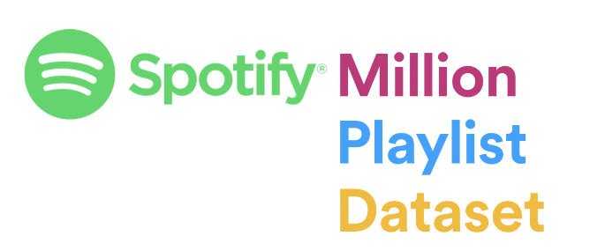
“The Spotify Million Playlist Dataset Challenge consists of a dataset and evaluation to enable research in music recommendations. It is a continuation of the RecSys Challenge 2018, which ran from January to July 2018. The dataset contains 1,000,000 playlists, including playlist titles and track titles, created by users on the Spotify platform between January 2010 and October 2017. The evaluation task is automatic playlist continuation: given a seed playlist title and/or initial set of tracks in a playlist, to predict the subsequent tracks in that playlist. This is an open-ended challenge intended to encourage research in music recommendations, and no prizes will be awarded (other than bragging rights).”
See Spotify Million Playlist Dataset Challenge
From aicrowd.com

Slide 8
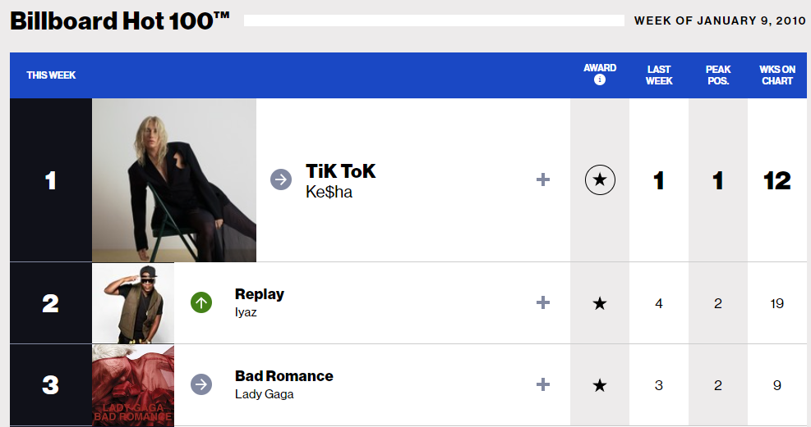
Published online
417 weeks = 417 pages
Method: Webscraping
3,460 songs entered the charts between January 2010 and October 2017
90 songs reached number one

Slide 9
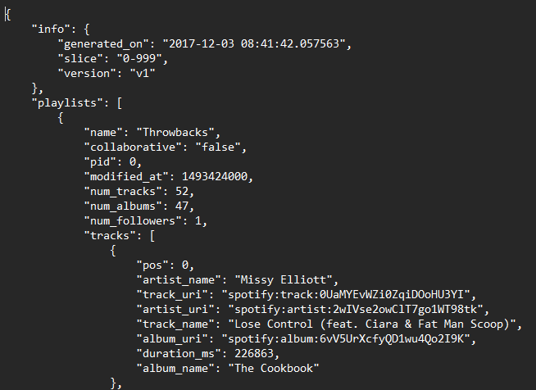
JSON files
1,000 playlists per file
1,000 files
Method: Pandas Loops
17.41% of the playlists in the Spotify Million Playlist Dataset were updated three or fewer times
Of the 174,083 playlists in this subset, 43,751 contain one or more No. 1 song.

Slide 12
18 songs across 40,542 playlists.
Did users add these songs before or after the song reached Number 1?
Let’s see.

Slide 13
Does Spotify user engagement with a song precede, contribute to, or follow its rise on the Billboard Hot 100 Charts?

Slide 14
Does Spotify user engagement with a song precede, contribute to, or follow its rise on the Billboard Hot 100 Charts?
Most recently, Spotify user engagement seems to follow, or be influenced by, the same factors that cause songs to rise on the Billboard Hot 100 chart.

Slide 15
Does Spotify user engagement with a song precede, contribute to, or follow its rise on the Billboard Hot 100 Charts?
Most recently, Spotify user engagement seems to follow, or be influenced by, the same factors that cause songs to rise on the
Billboard Hot 100 chart.
However…

Slide 16
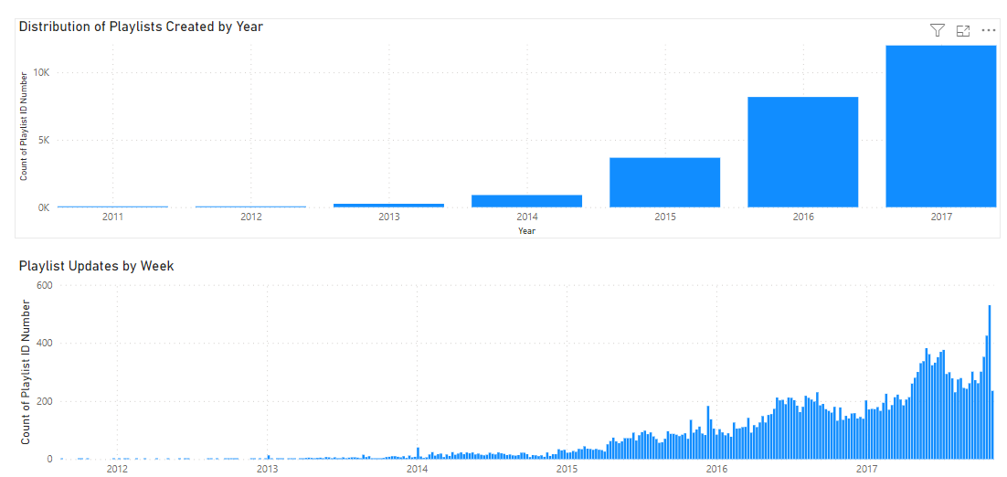
The Times Are A-Changin’: 2010 - 2017
Billboard reporting changes
Distribution of Spotify sample playlists by year
Increase in number of Spotify users
Improvements in Spotify services and UI
Changes in user trends and habits

Slide 17
What kind of insight could be gleaned if music data was centralized, organized, and shared across the industry?

Slide 18
What kind of insight could be gleaned if music data was centralized, organized, and shared across the industry?
Trends, influences, and insights for stakeholders. Transparency & fairness for creators.

Slide 19
What kind of insight could be gleaned if music data was centralized, organized, and shared across the industry?
Trends, influences, and insights for stakeholders. Transparency & fairness for creators.
Can data from two different sources be leveraged to draw useful conclusions about behavior trends?

Slide 20
What kind of insight could be gleaned if music data was centralized, organized, and shared across the industry?
Trends, influences, and insights for stakeholders. Transparency & fairness for creators.
Can data from two different sources be leveraged to draw useful conclusions about behavior trends?
Not… well.

Slide 21
I like music.
I work in music.
There’s a lot of data in music.
There’s not a lot of data centralization in recorded music.

Slide 22
I like music.
I work in music.
There’s a lot of data in music.
There’s not a lot of data centralization in music.
Data centralization in recorded music is a valuable and necessary endeavor that will allow recorded music to continue.

Slide 23
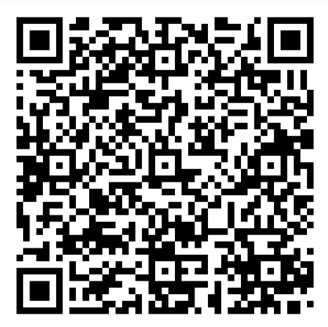
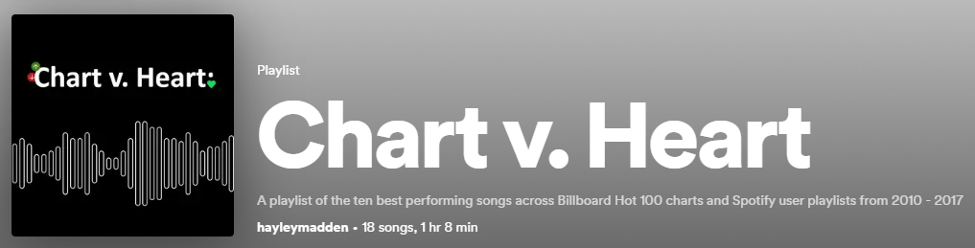
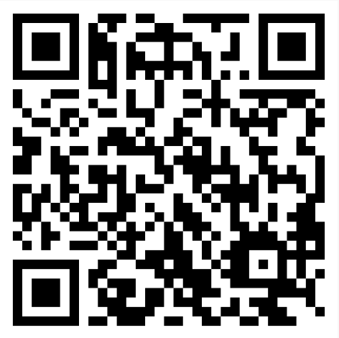
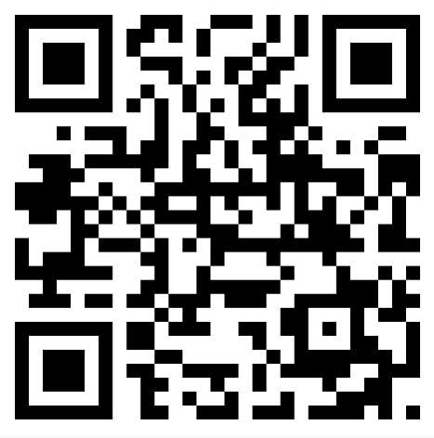


/hayleymadden
/hayleymadden

Slide 24

Chart v. Heart:

